Slide 1
Lesson 8 Basic Host Integration – PC/Real-Time
Windows Host Integration
Developing a Windows Host VI
Introduction to Real-Time
Developing an RT Host VI
Front Panel Communication
Developing a Windows VI
Shared Variable Network Communication
Prepare RT Host for Final Application

Slide 2
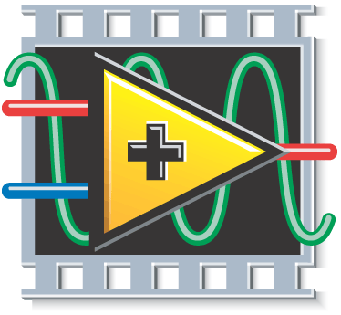

A. Windows Host Integration
Windows Computer (PC or PXI)
FPGA
Windows
Host VI
FPGA
Interface
LabVIEW
FPGA VI
User
Interface
LabVIEW
for Windows
LabVIEW FPGA

Slide 3
A. Windows Host Integration
Common Windows host VI tasks:
Transfer data between Windows computer and FPGA
User interface
Do more data processing than you can fit on the FPGA
Perform operations not available on the FPGA target
Floating-point math
Sequence multiple FPGA VIs
Log data
Control the timing and sequencing of data transfer
Coordinate operation of several FPGA targets
Coordinate operation of FPGA targets with other measurement devices in the computer
Notes:
A. Introduction
The external host program might provide a remote graphical user interface, log data, and post process data. The host program can run in Windows on a PC or PXI controller; or it can run on a real-time operating system (RTOS) on a PC, PXI controller, Compact Vision System, or CompactRIO controller. The RT host controller communicates with the CompactRIO RT processor over the network using shared variables or low-level protocols such as TCP/IP.
The Host VI can perform the following tasks in this architecture:
Perform more data processing than you can fit on the FPGA
Perform operations not available on the FPGA target, such as floating-point arithmetic
Provide a multi-tiered application with the FPGA target as a component of a larger system
Log data
Sequence multiple FPGA VIs
Control the timing and sequencing of data transfer
Control which components are visible on the front panel window because some controls and indicators might be more important for communication than others
Programmatic FPGA Interface Communication (FPGA Module)
With Programmatic FPGA Interface Communication, you programmatically monitor and control an FPGA VI with a separate host VI running on the host computer. You might write a host VI to send information between the host computer and the FPGA target for the following reasons:
You want to do more data processing than you can fit on the FPGA.
You need to perform operations not available on the FPGA target, such as floating-point arithmetic.
You want to create a multi-tiered application with the FPGA target as a component of a larger system.
You want to log data.
You want to control the timing and sequencing of data transfer.
When you use Programmatic FPGA Interface Communication, the FPGA VI runs on the FPGA target, and the host VI runs on the host computer, as shown in the following illustration. Use the FPGA Interface Functions available for a Windows VI or a Real-Time target VI to create a host VI that communicates with the FPGA VI and performs other required functions.

Slide 4
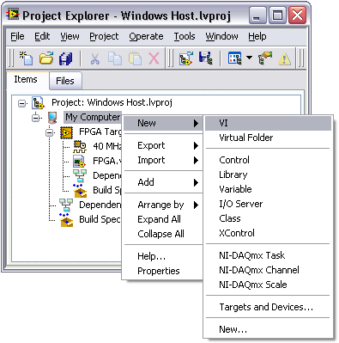
B. Developing a Windows Host VI
Add a VI under My Computer
Note: The contents of right-click menus differ from those in this image depending on the software installed on your computer.

Slide 5
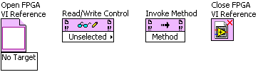
FPGA Interface Functions
Establish communication with a FPGA VI from a host VI
Control the execution of the FPGA VI on the FPGA target
Read and write data to the FPGA VI
Terminate communication with the FPGA VI
Notes:
Instructor: Walk through this palette for a quick discussion of other items available.
FPGA Interface Functions
When you install the LabVIEW FPGA modules in LabVIEW, if you open a VI under the host in the project hierarchy, the FPGA Interface Functions palette is available, as shown above.
Use the FPGA Interface functions to communicate with an FPGA VI from the host VI using the following operations:
Establish and terminate communication with the FPGA VI
Control the execution of the FPGA VI on the FPGA target
Read and write data to the FPGA VI
The FPGA Interface functions can return general LabVIEW error codes, specific FPGA interface error codes, or error codes specific to the FPGA target. Refer to the specific FPGA target documentation for a list of target-specific error codes.

Slide 6

Open FPGA VI Reference
Opens a reference to:
the FPGA build specification, FPGA VI, or bitfile
and FPGA target
Must open a reference to establish communication between the host and the FPGA
FPGA target may be specified
Explicitly, in all cases, by wiring the reference name input or
Implicitly, when opening a reference to an FPGA build specification or an FPGA VI
Notes:
Open FPGA VI Reference Function
Opens a reference to the FPGA VI or bitfile and FPGA target you specify. Right-click the Open FPGA VI Reference function and select Configure Open FPGA VI Reference from the shortcut menu to display the Configure Open FPGA VI Reference dialog box.
You must open a reference to the FPGA target before you can communicate between the host VI and the FPGA VI. You can download and run only one FPGA VI at a time on a single FPGA target. If you attempt to download a second VI to the FPGA target while the first FPGA VI is still in use, LabVIEW reports an error and the download fails.
Note: You can use the Open FPGA VI Reference function to interface with an FPGA bitfile even if you do not have the FPGA Module installed.

Slide 7
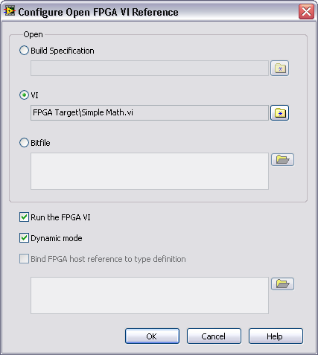
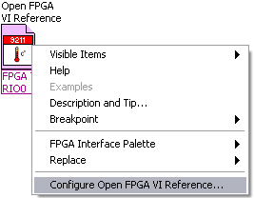
Open FPGA VI Reference Configuration
Select build specification, VI, or bitfile
Specify whether to run the FPGA VI if it is not already running when you run the host VI
Enable/Disable Dynamic mode. When you enable Dynamic mode, you can write reusable subVIs based on the FPGA VI reference.
Notes:
Open FPGA VI Reference
Opens a reference to the FPGA VI or bitfile and FPGA target you select in the shortcut menu or that you specify with the resource name input. You must open a reference to the FPGA target before you can communicate between the host VI and the FPGA VI.

Slide 8

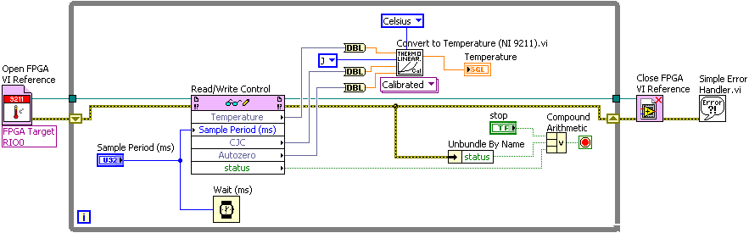
Read/Write Control
Reads a value from or writes a value to a control or indicator in the top-level FPGA VI on the FPGA target.
Notes:
Read/Write Control
Reads a value from or writes a value to a control or indicator in the FPGA VI on the FPGA target.

Slide 9

Invoke Method
Invokes method or action from a host VI
The following methods are supported by most targets:
Run
Abort
Get FPGA VI Execution Mode
Reset
Wait on IRQ
Acknowledge IRQ
Download
DMA FIFOs
Configure
Read
Start
Stop
Write
Your target may support additional target-specific methods
Notes:
Invoke Method
Invokes an FPGA Interface method or action from a host VI on an FPGA VI. Use methods to download, abort, reset, and run the FPGA VI on the FPGA target, wait for and acknowledge FPGA VI interrupts, read DMA FIFOs, and write to DMA FIFOs. The methods you can choose from depend on the target hardware and the FPGA VI. You must wire the FPGA VI Reference In input to view the available methods in the shortcut menu.

Slide 10

Close FPGA VI Reference
By default, stops and resets the FPGA
Right-click and select Close from the shortcut menu to close the reference without resetting
Default is Close and Reset if Last Reference, which closes the reference, stops the FPGA VI, and resets the FPGA
Use free label to describe functionality
Notes:
Close FPGA VI Reference
Stops and resets the FPGA VI running on the FPGA target and closes the reference to the VI. Right-click the Close FPGA VI Reference function on the block diagram and select Close to close the reference without resetting the FPGA VI running on the FPGA target. The default is Close and Reset if Last Reference, which closes the reference, stops the FPGA VI, and resets the FPGA VI running on the FPGA target.

Slide 11
Developing a Windows Host VI
FPGA host interface functions on the Windows host VI control and communicate with the FPGA VI
Expose only necessary controls and indicators on the FPGA VI
Use the host VI to write values to the FPGA VI
Do not write values to the FPGA VI using the front panel of the FPGA VI

Slide 12
Exercise 8-1: Windows Host Integration
Create a user interface on a Windows host system that interacts with an FPGA VI on a simulated PCI-7831R R-Series board.
Notes:
Prep discussion:
In this exercise, the student has been assigned the task of creating an FPGA application that continuously acquires data from an analog input channel of the PCI-7831R FPGA board and outputs a high voltage on a digital output line if the analog input value is exceeds the threshold. You must design the application so that the user communicates with the FPGA through a VI running on a Windows system.
The user needs to set the threshold in units of voltage and see the analog input values in units of voltage using the front panel of the Windows host VI. Because the front panel will use voltage units and the analog input FPGA I/O node uses binary units, the Windows host VI will need to handle the conversions between voltage and binary units.
The student is given a pre-built FPGA VI and will develop the Windows host VI to communicate with the FPGA VI.

Slide 13
Exercise 8-1: Windows Host Integration
What functionality does the Windows host VI accomplish that the FPGA VI could not?
Will the same scaling calculations work for I/O channels that have a different resolution and voltage range?
Notes:
Double-precision calculations such as divide.
No. The scaling calculations in this exercise work specifically for a 16-bit resolution and -10V to +10V voltage range.

Slide 14

LabVIEW FPGA Architecture with LabVIEW Real-Time: RT Host VI
Windows System
LabVIEW Real-Time System
Reconfigurable
FPGA
Network
Communication
Inter-Thread
Communication
FPGA
Interface
Windows
VI
Normal Priority
Loop
Time-Critical
Loop
LabVIEW
FPGA VI
User
Interface
RT Host VI
Enterprise
Data Storage
LabVIEW
for Windows
LabVIEW FPGA
LabVIEW Real-Time
Notes:
FPGA for Real-Time is the other major architecture. It uses LabVIEW FPGA within a LabVIEW Real-Time System. This is the architecture for PXI and CompactRIO platforms that run LabVIEW Real-Time. This architecture has the following components:
LabVIEW FPGA VI—Implements custom I/O or ultra high-speed control. Because your LabVIEW code executes directly in hardware, you can achieve hardware-level (ns) determinism.
LabVIEW Real-Time Module—Adds deterministic floating-point processing and control algorithms on a dedicated processor.
LabVIEW for Windows Host VI—Contains the user interface for your real-time system.
Refer to the LabVIEW Real-Time 1 customer education course or visit ni.com/realtime for more information about developing well-architected LabVIEW Real-Time applications.

Slide 15
C. Introduction to Real-Time
Windows User Interface
Windows
RT Controller
Computer
FPGA
Windows VI
RT VI(s)*
FPGA VI
*Usually a Time Critical VI and a Normal Priority Communication
Stand alone
Stand alone
Stand alone
Stand alone
RT CompactRIO Controller
cRIO Controller
RT Controller
RT Controller
FPGA
FPGA
FPGA
FPGA
RT VI(s)
RT VI(s)
FPGA VI
FPGA VI
FPGA VI
FPGA VI
Common RT Configurations

Slide 16
Introduction to Real-Time
Advantages of Using a Real-time Host
Code execution is more deterministic
Ability to set tasks to run at different priorities including a time-critical priority
Ability to separate deterministic tasks from non-deterministic tasks
Real-time OS is more stable than Windows OS
Real-time targets can have 1MHz clocks (Windows has a 1kHz clock)

Slide 17
RT Host VI Common Tasks
Data processing
Perform operations not available on the FPGA target
Floating-point math
Sequence multiple FPGA VIs
Log data
Run multiple VIs
Control the timing and sequencing of data transfer
Coordinate operation of several FPGA targets
Coordinate operation of FPGA targets with other measurement devices in the computer
Control which components are visible on the Windows user interface VI if applicable

Slide 18
The LabVIEW Real-Time 1 Course
Configuring CompactRIO system
Real-time application design
Multithreading
Passing data between threads
Improving determinism
Priority levels
Memory management
Timed structures
Event response
Shared variables with RT FIFO
Network-published shared variables
Verifying timing and memory usage
Execution Trace Tool Kit
Deploying an application
Remote panels

Slide 19
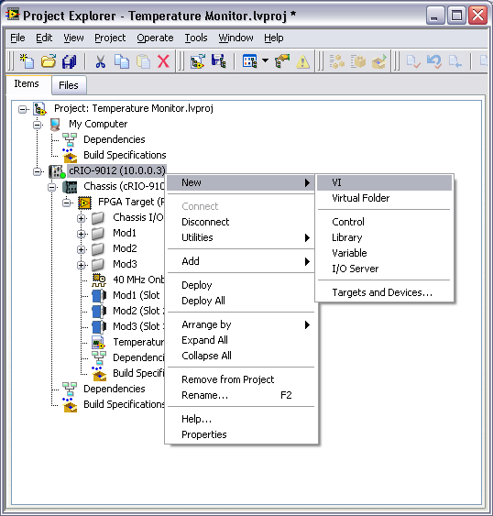
D. Developing an RT Host VI
Add a VI under the RT target

Slide 20
Developing an RT Host VI
FPGA Interface Functions
Used the same way whether programming a Windows Host VI or RT Host VI

Slide 21
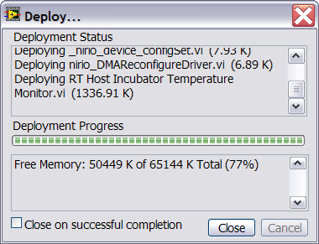
Developing an RT Host VI
After developing the RT host VI, run it
Deploying Status Window:

Slide 22
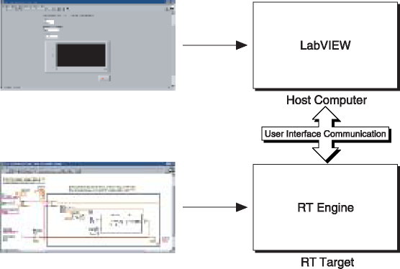
E. Front Panel Communication in LabVIEW Real-Time
Targeted
Notes:
Front Panel Communication
With front panel communication, the host computer and the RT target execute different parts of the same VI, as shown in the figure above. On the host computer, LabVIEW displays the front panel of the VI while the RT target executes the block diagram. A user interface thread handles the communication between LabVIEW and the RT Engine.
Use front panel communication between LabVIEW on the host computer and the RT Engine to control and test VIs running on an RT target. After downloading and running the VIs, keep LabVIEW on the host computer open to display and interact with the front panel of the VI.

Slide 23
Front Panel Communication in LabVIEW Real-Time
Advantages
Debug VIs
Quickly monitor VIs running on RT target during development
Caveats
You should not use Front Panel Communication for a final RT application
Learn how to build a proper final RT application in the LabVIEW Real-Time 1 course
Notes:
Front Panel Communication
You also can use front panel communication to debug VIs while they run on the RT target. You can use LabVIEW debugging tools such as probes, execution highlighting, breakpoints, and single stepping to locate errors on the block diagram. Front panel communication is a good communication method to use during development, because you can quickly monitor and interface with VIs running on an RT target.
Front panel communication causes sections of code that contain front panel controls and indicators to be non-deterministic. This is because LabVIEW must switch to the user interface thread, which is non-deterministic, to complete the task. Therefore if you are using front panel communication, you should not place front panel controls and indicators in time-critical sections of code. If no front panel terminals are in the time-critical section of code, then the time-critical section of code will run deterministically.

Slide 24
LabVIEW FPGA Architecture with LabVIEW Real-Time: Windows VI
Windows PC/PXI
LabVIEW Real-Time System
FPGA
Network
Communication
Inter-Thread
Communication
FPGA
Interface
Windows
VI
Normal Priority
VI
Time-Critical
Interface VI
LabVIEW
FPGA VI
User
Interface
Enterprise
Data Storage
LabVIEW
for Windows
LabVIEW FPGA
LabVIEW Real-Time
Notes:
FPGA for Real-Time is the other major architecture. It uses LabVIEW FPGA within a LabVIEW Real-Time System. This is the architecture for PXI and CompactRIO platforms that run LabVIEW Real-Time. This architecture has the following components:
LabVIEW FPGA VI—Implements custom I/O or ultra high-speed control. Because your LabVIEW code executes directly in hardware, you can achieve hardware-level (ns) determinism.
LabVIEW Real-Time Module—Adds deterministic floating-point processing and control algorithms on a dedicated processor.
LabVIEW for Windows Host VI—Contains the user interface for your real-time system.
Refer to the LabVIEW Real-Time 1 customer education course or visit ni.com/realtime for more information about developing well-architected LabVIEW Real-Time applications.

Slide 25
F. Developing a Windows VI
Windows VI possible tasks:
Act as a user-interface
Send data and commands to RT host VI
ActiveX and .NET functionality
Database connectivity
Log data
Data processing

Slide 26
Developing a Windows VI
Use network communication to transfer data between a Windows system and an RT target
Network communication allows you to
Run a VI on the RT target and a VI on the Windows system
Control the data exchanged
which front panel objects on the PC get updated and when
which RT target VI components are visible on the front panel of the Windows VI
Control timing and sequencing of the data transfer
Perform additional data processing or logging

Slide 27
G. Shared Variable Network Communication
Network-published Shared variables automatically publish data values over an Ethernet network
Shared variables communicate between
Parallel processes
Between VIs
Between computers

Slide 28
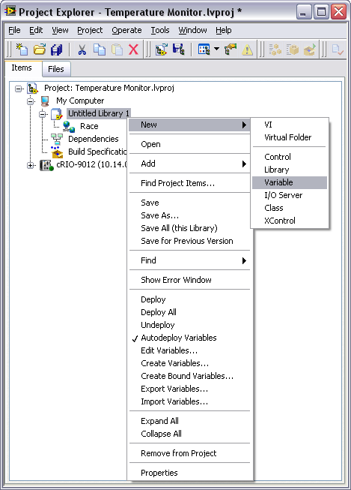
Creating Shared Variables
Create Shared Variables from the Project Explorer window
Shared Variables must be inside project libraries
LabVIEW automatically creates the library with the shared variable inside

Slide 29
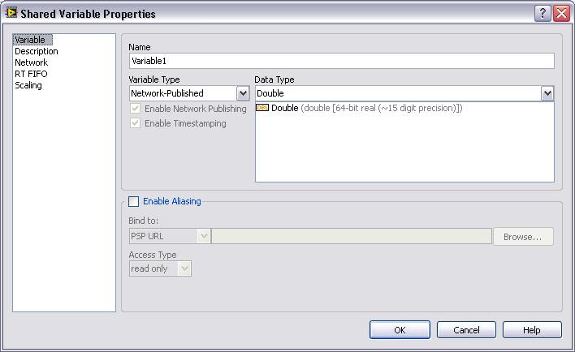
Shared Variable Configuration
Configuring Network-published shared variables
Set Variable Type to Network-published

Slide 30
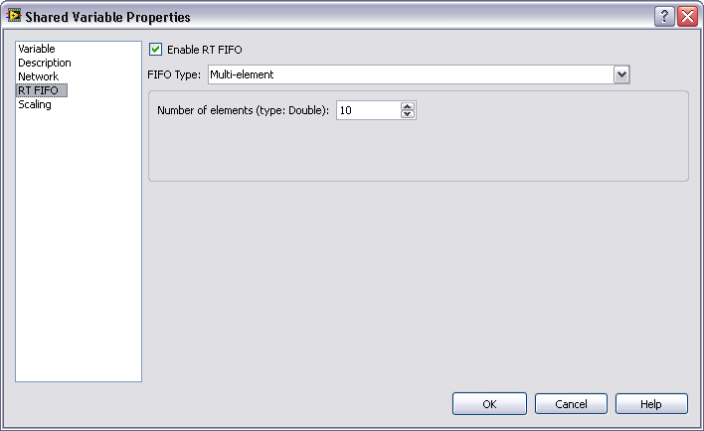
Shared Variable with RT FIFO
RT FIFO category
Enable RT FIFO
Shares data across a network without affecting the determinism of the VIs
FIFO Type
Single Element
Multi-element
Number of elements
Notes:
Network-Published Shared Variables—You can use network-published shared variables to share data between VIs running on different targets across a network. By enabling the real-time FIFO of a shared variable, you can share data across a network without affecting the determinism of the VIs. However, the transfer of the data across the network is not deterministic. Due to network latency, the most recently written data may not be available to a VI running on a machine across the network. In this case, the VI attempting to read from the network-published shared variable returns the previous value. For datalogging applications, you can use timestamps to programmatically ensure that each value is logged once and only once.

Slide 31
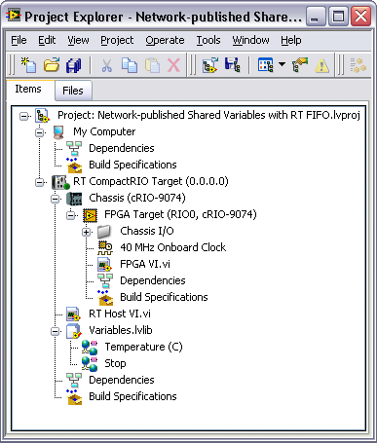
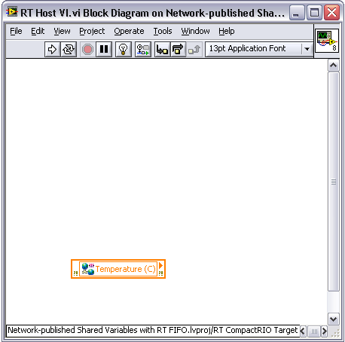
Shared Variable Programming

Slide 32
Network Communication Methods
There are multiple methods of transferring data between the VI running on the RT target and the VI running on the Windows system
Network-published shared variables
Network-published shared variables with RT FIFO enabled
TCP
UDP
This is covered in the LabVIEW Real-Time 1 course

Slide 33
Exercise 8-2: RT Host and Windows Integration
Develop an RT host VI that communicates with the FPGA and Windows VI that serves as a user interface for the Temperature Monitor project.
Notes:
Prep discussion:
The student is assigned the task of developing a user interface for a PC for the Temperature Monitor application. The user interface displays the temperature versus time in a graph, stops the CompactRIO controller and FPGA applications, controls the sample rate, and logs the data to the PC hard drive. The CompactRIO starts and runs independently of the Windows host.
The student is given a pre-built FPGA VI and RT Host VI. The student will modify the RT Host VI to use network-published shared variables to communicate with the Windows VI that they will create.

Slide 34
Exercise 8-2: RT Host and Windows Integration
Why was the temperature conversion to units of Celsius done in the RT Host VI instead of the FPGA VI?
What are the advantages of writing data to file on a Windows VI, and what would be the advantages of writing data to file on a RT Host VI?
Notes:
The temperature conversion calculation required using double-precision numbers which are not supported the FPGA target.
Windows PCs typically have larger hard drives.
Real-Time targets are more stable and reliable than Windows targets.

Slide 35
H. Prepare RT Host VI for Final Application
For final RT application
Do not use Front Panel Communication
Compile the RT VI into a startup EXE or startup VI
For more information, see the LabVIEW Real-Time 1 course

Slide 36
Summary—Quiz
Match the task with the VI in a FPGA/RT architecture
Logging data to file
I/O operations
Floating-point math
User interface
40 MHz logic
Inserting data into an enterprise database
Separating deterministic and non-deterministic tasks
FPGA VI
RT Host VI
Windows User Interface VI
Notes:
Answer is:
Logging data to file– B and C*
I/O operations – A
Floating-point math – B and C
User Interface – C
40 MHz logic – A
Inserting data into an enterprise database – C
Separating deterministic and non-deterministic tasks – B
* There is a cRIO module you can use to log data to file using an FPGA VI (NI 9802)

Slide 37
Summary—Quiz Answers
Match the task with the VI in a FPGA/RT architecture
Logging data to file (B,C)
I/O operations (A)
Floating-point math (B,C)
User interface (C)
40 MHz logic (A)
Inserting data into an enterprise database (C)
Separating deterministic and non-deterministic tasks (B)
FPGA VI
RT Host VI
Windows User Interface VI
Notes:
Answer is:
Logging data to file– B and C*
I/O operations – A
Floating-point math – B and C
User Interface – C
40 MHz logic – A
Inserting data into an enterprise database – C
Separating deterministic and non-deterministic tasks – B
* There is a cRIO module you can use to log data to file using an FPGA VI (NI 9802)

Slide 38
Summary—Quiz
Which of the following should you use in the host VI to communicate with the FPGA VI?
Array functions
Network-published shared variables
FPGA Interface VIs
TCP/IP VIs
Notes:
The answer is c.

Slide 39
Summary—Quiz Answer
Which of the following should you use in the host VI to communicate with the FPGA VI?
Array functions
Network-published shared variables
FPGA Interface VIs
TCP/IP VIs
Notes:
The answer is c.

Slide 40
Summary—Quiz
Which of the following are necessary in a host VI that reads and writes values of controls and indicators on the FPGA VI?
Open FPGA VI Reference
Read/Write Control
Invoke Method
Close FPGA VI Reference
Notes:
The answer is a, b, and d.

Slide 41
Summary—Quiz Answer
Which of the following are necessary in a host VI that reads and writes values of controls and indicators on the FPGA VI?
Open FPGA VI Reference
Read/Write Control
Invoke Method
Close FPGA VI Reference
Notes:
The answer is a, b, and d.

Slide 42
Summary—Quiz
You should use Interactive Front Panel Communication in your final RT application.
True
False
Notes:
Answer is False.

Slide 43
Summary—Quiz
You should use Interactive Front Panel Communication in your final RT application.
True
False
Notes:
Answer is False.

